Slide 1
Job Analysis
Lecture 4
Notes:
Managers should determine what a job entails before deciding who to recruit and select for the job. The main purpose of this chapter is to show you how to determine what a job entails, by analyzing a job and writing a job description for it.

Slide 2
Discuss the process of job analysis and its importance.
Notes:
For this learning objective, we will look more closely at a variety of important considerations such as:
What job analysis information typically is used for
How to conduct a job analysis
Job analysis guidelines
How to collect job analysis information

Slide 3
The Basics of Job Analysis
Work activities
Human Behaviors
Machines, tools, equipment, and work aids
Performance standards
Job context
Human requirements
Notes:
For this learning objective, we will look more closely at a variety of important considerations such as:
What job analysis information typically is used for
How to conduct a job analysis
Job analysis guidelines
How to collect job analysis information

Slide 4
The Basics of Job Analysis
Work activities: First, he or she collects information about the job s actual work activities, such as cleaning, selling, teaching, or painting. This list may also include how, why, and when the worker performs each activity.
Human Behaviors: Information about human behaviors the job requires, like sensing, communicating, lifting weights, or walking long distances.
Machines, tools, equipment, and work aids: Information regarding tools used, materials processed, knowledge dealt with or applied (such as finance or law), and
services rendered (such as counseling or repairing).
Notes:
Talent management begins with understanding what jobs need to be filled, and the human traits and competencies employees need. Jobanalysis is the procedure through which you determine the duties of the positionsand the characteristics of the people to hire for them.

Slide 5
The Basics of Job Analysis
Performance standards: Information about the job s performance standards (in terms of quantity or quality levels for each job duty, for instance).
Job context: Information about such matters as physical working conditions, work schedule, incentives, and, for instance, the number of people with whom the employee would normally interact.
Human requirements: Information such as knowledge or skills (education, training, work experience) and required personal attributes (aptitudes, personality, interests).
Notes:
Talent management begins with understanding what jobs need to be filled, and the human traits and competencies employees need. Jobanalysis is the procedure through which you determine the duties of the positionsand the characteristics of the people to hire for them.

Slide 6
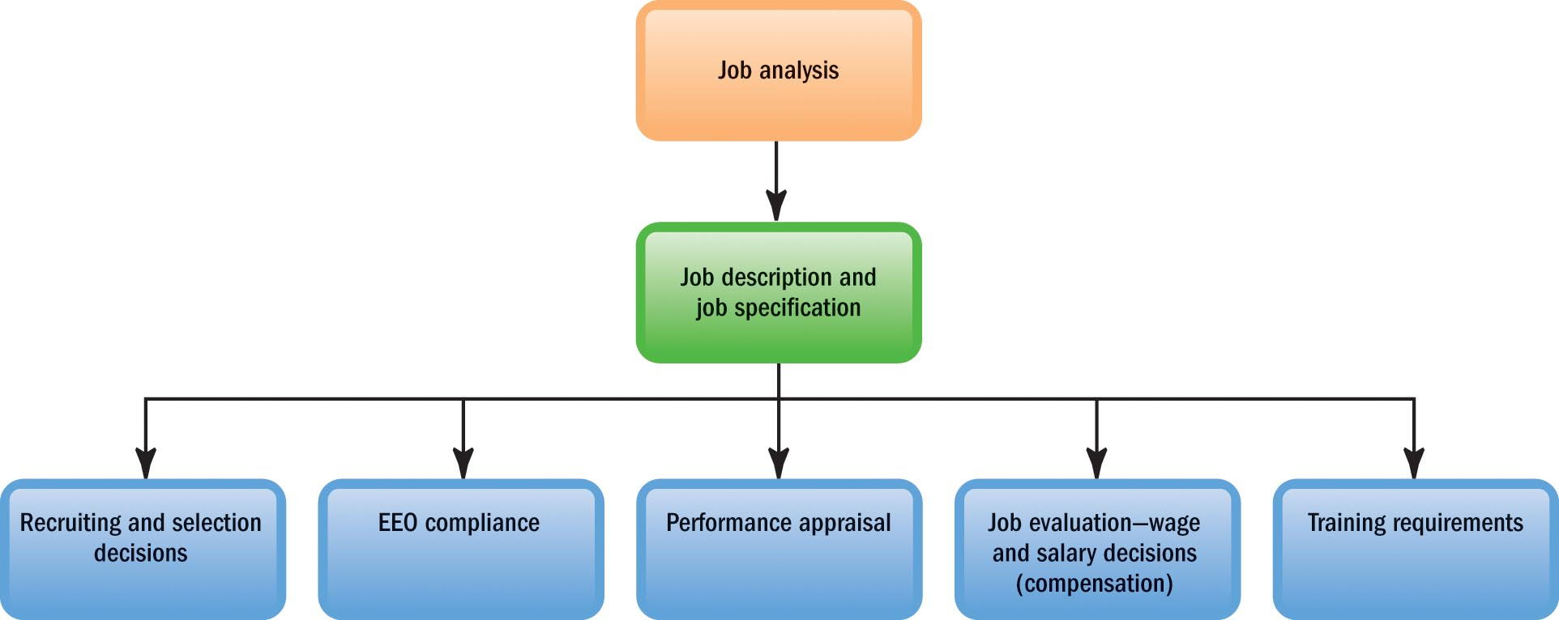
Uses of Job Analysis Information
Recruitment and selection
EEO compliance
Performance appraisal
Compensation
Training
Notes:
The information collected through a job analysis is used help manage all aspects of an effective HR program.
In terms of recruitment and selection information about what duties the job entails and what human characteristics are required helps in hiring decisions.
Job analysis is crucial for validating all major human resources practices, especially when it comes to legal compliance. You may recall from our earlier discussion of federal laws that care must be exercised in all areas related to employees such as hiring under the Americans with Disabilities Act (ADA).
A job analysis helps compare each employee’s actual performance with his or her duties and performance standards in performance appraisals.
Compensation often depends onthe job’s required skill and education level, safety hazards, degree of responsibility, and other factors you assess through job analysis.
The job description, which is created from a job analysis, lists the job’s specific duties and skills—and therefore the training—that the job requires.

Slide 7
Uses of Job Analysis Information
Recruitment and selection: Information about what duties the job entails and what human characteristics are required to perform these activities helps managers decide what sort of people to recruit and hire.
EEO compliance: Job analysis is crucial for validating all major human resources practices. For example, to comply with the Americans with Disabilities Act, employers should know each job s essential job functions which in turn requires a job analysis.
Performance appraisal: A performance appraisal compares each employee s actual performance with his or her duties and performance standards. Managers use job analysis to learn what these duties and standards are.
Notes:
The information collected through a job analysis is used help manage all aspects of an effective HR program.
In terms of recruitment and selection information about what duties the job entails and what human characteristics are required helps in hiring decisions.
Job analysis is crucial for validating all major human resources practices, especially when it comes to legal compliance. You may recall from our earlier discussion of federal laws that care must be exercised in all areas related to employees such as hiring under the Americans with Disabilities Act (ADA).
A job analysis helps compare each employee’s actual performance with his or her duties and performance standards in performance appraisals.
Compensation often depends onthe job’s required skill and education level, safety hazards, degree of responsibility, and other factors you assess through job analysis.
The job description, which is created from a job analysis, lists the job’s specific duties and skills—and therefore the training—that the job requires.

Slide 8
Uses of Job Analysis Information
Compensation: Compensation (such as salary and bonus) usually depends on the job s required skill and education level, safety hazards, degree of responsibility, and so on all factors you assess through job analysis.
Training: The job description lists the job s specific duties and requisite skills and therefore the training that the job requires.
Notes:
The information collected through a job analysis is used help manage all aspects of an effective HR program.
In terms of recruitment and selection information about what duties the job entails and what human characteristics are required helps in hiring decisions.
Job analysis is crucial for validating all major human resources practices, especially when it comes to legal compliance. You may recall from our earlier discussion of federal laws that care must be exercised in all areas related to employees such as hiring under the Americans with Disabilities Act (ADA).
A job analysis helps compare each employee’s actual performance with his or her duties and performance standards in performance appraisals.
Compensation often depends onthe job’s required skill and education level, safety hazards, degree of responsibility, and other factors you assess through job analysis.
The job description, which is created from a job analysis, lists the job’s specific duties and skills—and therefore the training—that the job requires.

Slide 9
Conducting a Job Analysis
STEP 1: DECIDE HOW YOU WILL USE THE INFORMATION
STEP 2: REVIEW RELEVANT BACKGROUND INFORMATION SUCH AS ORGANIZATION CHARTS, PROCESS CHARTS, AND JOB DESCRIPTIONS
STEP 3: SELECT REPRESENTATIVE POSITIONS
STEP 4: ACTUALLY ANALYZE THE JOB BY COLLECTING DATA ON JOB ACTIVITIES, WORKING CONDITIONS, AND HUMAN TRAITS AND ABILITIES NEEDED TO PERFORM THE JOB
STEP 5: VERIFY THE JOB ANALYSIS INFORMATION WITH THE WORKER PERFORMING THE JOB AND WITH HIS OR HER IMMEDIATE SUPERVISOR
STEP 6: DEVELOP A JOB DESCRIPTION AND JOB SPECIFICATION
Notes:
Conducting a job analysis requires multiple steps.
Step 1: Decide how you’ll use the information.
Step 2: Review relevant background information such as organization charts, process charts, and job descriptions.
Step 3: Select representative positions.
Step 4: Actually analyze the jobby collecting data on job activities, working conditions, and human traits and abilities needed to perform the job.
Step 5: Verify the job analysis information with the worker performing the job and with his or her immediate supervisor.
Step 6: Develop a job description and job specification.
Job analysis may involve these processes:
Workflow analysis is a detailed study of the flow of work from job to job in a work process. Usually, the analyst focuses on one identifiable work process, rather than on how the company gets all its work done.
Business Process Reengineering Business process reengineering means redesigning business processes, usually by combining steps, so that small multifunction teams, often using information technology, do the jobs formerly done by a sequence of departments.
The basic reengineering approach is to:
1. Identify a business process to be redesigned (such as processing an insurance claim)
2. Measure the performance of the existing processes
3. Identify opportunities to improve these processes
4. Redesign and implement a new way of doing the work
5. Assign ownership of sets of formerly separate tasks to an individual or a team who use new
computerized systems to support the new arrangement
As at Atlantic American, reengineering usually requires redesigning individual jobs.
Job redesign Researches proposed redesigning jobs using methods such as job enlargement, job rotation, and job enrichment.
Job enlargement means assigning workers additional same-level activities. Thus, the worker who previously only bolted the seat to the legs might attach the back too.
Job rotation means systematically moving workers from one job to another.
Job enrichment means redesigning jobs in a way that increases the opportunities for the worker to experience feelings of responsibility, achievement, growth, and recognition—and therefore more motivation. It does this by empowering the worker—for instance, by giving the worker the skills and authority to inspect the work, instead of having supervisors do that. Herzberg said empowered employees would do their jobs well because they wanted to, and quality and productivity would rise. That philosophy, in one form or another, is the theoretical basis for the team-based self-managing jobs in many companies around the world today.

Slide 10
Methods for Collecting Job Analysis Information
Interviews
Questionnaires
Observation
Diary/logs
Quantitative techniques
Internet-based
Notes:
Job analysis interviews range from completely unstructured interviews to highly structured ones. We will discuss interviews in more detail on the next slide.
Having employees fill out questionnaires to describe their job-related duties and responsibilities is another popular way to obtain job analysis information.
Direct observation is especially useful when jobs consist mainly of observable physical activities—assembly-line worker and accounting clerk are examples.
Another method is to ask workers to keep a diary/log of what they do during the day. For every activity engaged in, the employee records the activity (along with the time) in a log.
Qualitative methods like interviews and questionnaires are not always suitable. You may need to say that, in effect, “Job A is twice as challenging as Job B, and so is worth twice the pay.” Now, of course, you must be able to prove such a claim quantitatively. The position analysis questionnaire (PAQ) is a very popular quantitative job analysis tool, consisting of a questionnaire containing 194 items. The 194 items (such as “written materials”) each represent a basic element that may play a role in the job.
Experts at the U.S. Department of Labor (DOL) did much of the early work developing job analysis. The DOL method uses a set of standard basic activities called worker functions to describe what a worker must do with respect to data, people, and things.
For internet-based job analysis, the HR department can distribute standardized job analysis questionnaires to geographically disbursed employees. Such questionnaires may be sent via company intranets, and include instructions to complete the forms and return them by a particular date.

Slide 11
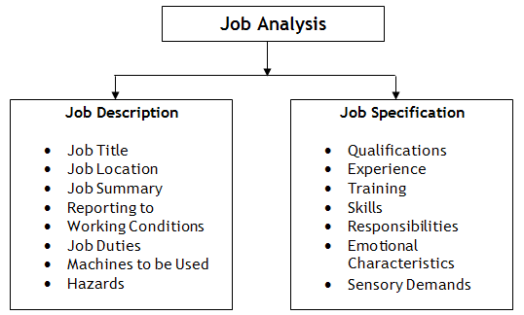

Slide 12
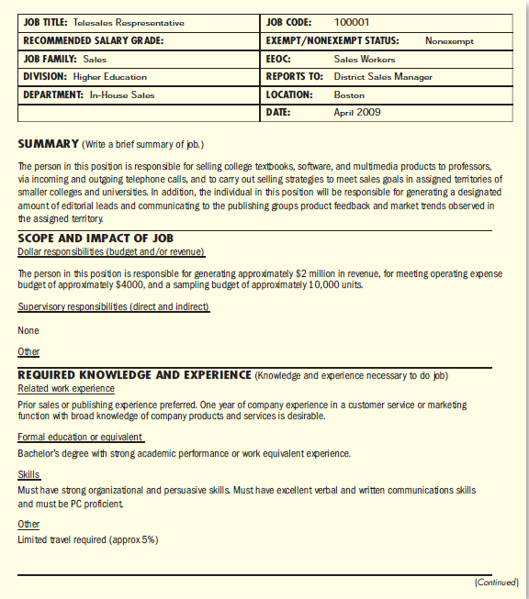

Slide 13
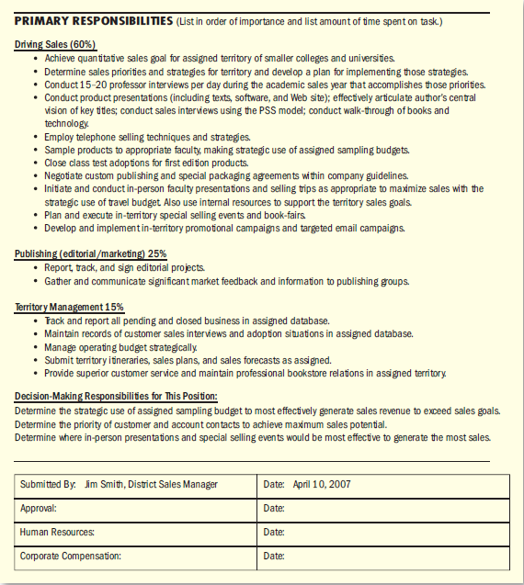

Slide 14
Online Helpers for Job Analysis
Many managers and small business owners face two hurdles when doing job analyses and job descriptions. First, they need a streamlined approach for developing a job description. Second, they fear that they will overlook duties that subordinates should be assigned. You have three good options.
The Standard Occupational Classification, mentioned earlier, provides detailed descriptions of thousands of jobs and their human requirements.
Web sites like www.jobdescription.com provide customizable descriptions by title and industry.
And the Department of Labor s O*NET is a third option. (http://online.onetcenter.org)

